Slide 1
Machine learning models for analyzing and interpreting genomics and proteomics data
Pawar

Slide 2
Sequence Analysis
Utilizing neural networks (Restricted Boltzmann machine’s) and clustering algorithms to identify certain important, representative HIV-1 PR sequences from a pool of several hundred sequences.
Analysis of drug resistance in HIV protease, Shrikant Pawar, Chris Freas, Robert W. Harrison, and Irene T. Weber, BMC: Bioinformatics
Structural studies of antiviral inhibitor with HIV-1 protease bearing drug resistant substitutions of V32I, I47V and V82I, Shrikant Pawar, Yuan-FangWang, Andres Wong-Sam, Johnson Agniswamy, Arun K. Ghosh, Robert W. Harrison, and Irene T. Weber, Elsevier: Biochemical and Biophysical Research Communications

Slide 3
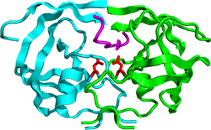
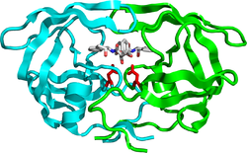
HIV-1 Protease Action
Hydrolyze peptide bonds
on the Gag-Pol polyproteins
Mature, fully functional
proteins
Infectious viral
particle
HIV-1 Protease
Competitive inhibition of PR prevents
virus maturation
Protease inhibitor: DRV
No infectious viral particle

Slide 4
Drug resistance is a severe problem
Patient 1
Patient 2
Patient 3
Patient 4
PQVTLWQRPI VTIKIGGQLK EALLDTGADN TVLEEMSLPG KWKPKMIGGI GGFIKVRQYD QVSIEICGHI AIGTVLIGPT PVNIIGRNLL TQLGCTLNF
Patient 5
Patient 6
Patient 7
Patient n
~100,000 sequences
Major and minor mutations
associated with resistance to all clinical protease inhibitors
Adapted from Weber, Kneller, Wong-Sam. Future Med Chem 2015

Slide 5

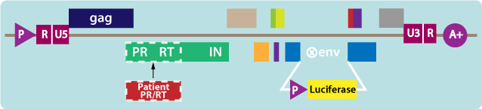
Phenotype Data
Genotype Data
Next-generation deep sequencing
Overall 5000 isolates for PI, NRTI
Resistance Fold
Seq ID FPV IDV NFV SQV ~100,000 sequences can be classified as resistant or non-resistant
12861 0.4 0.5 7.1 0.5
PQVTLWQRPI VTIKIGGQLK EALLDTGADN TVLEEMSLPG KWKPKMIGGI GGFIKVRQYD QVSIEICGHI AIGTVLIGPT PVNIIGRNLL TQLGCTLNF
Can machine learning help in selecting few drug resistant PR sequences for structure guided drug design?

Slide 6
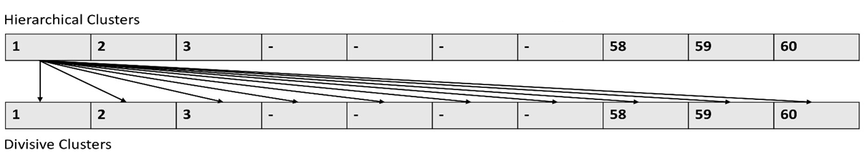
Analysis Pipeline
Coordinates for WT HIV-1 PR with its protein sequence information
Encode WT protein sequence and structure with Delaunay triangulation
Represent all the isolate sequences from Stanford database in form of 210 vectors
Apply RBM, SVM and RF for checking encoding accuracy
K means, Agglomerative and Divisive Clustering
Select sequences using intersection amongst techniques
Encoding Selection

Slide 7
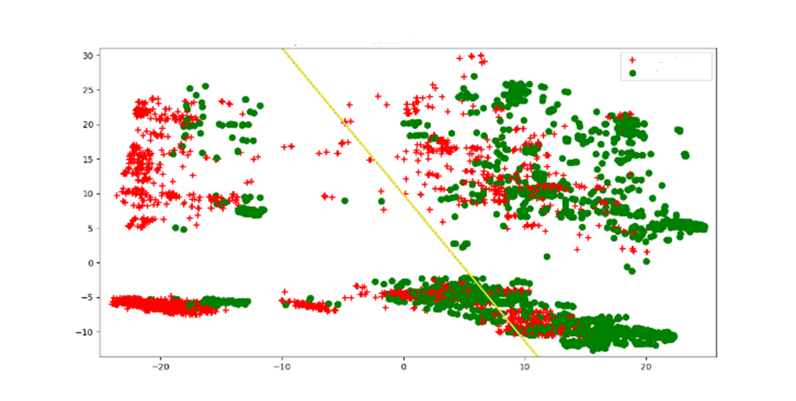
Representative plot with separation of sequences for inhibitor FPV with Support Vector Machine
Resistant Sequences
Non-Resistant Sequences
X and Y axis are weight vectors
Three, five- and ten-fold accuracies for SVM and RF ranged from 0.95-0.99. RBM also selected sequences in range 0.91-0.97.
These accuracies are better than Yu. Et. al. 2014 where she got SVM accuracies ranging from 0.93-0.96.
These accuracies are comparable with Shen. Et. al. 2016 where he got RF accuracies ranging from 0.98-0.99.

Slide 8
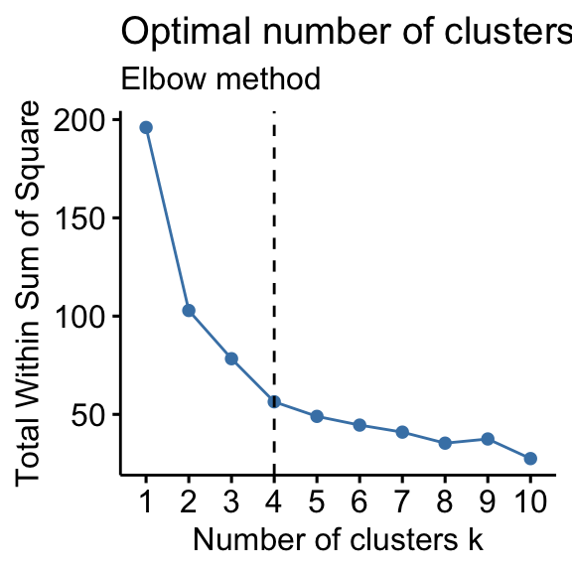
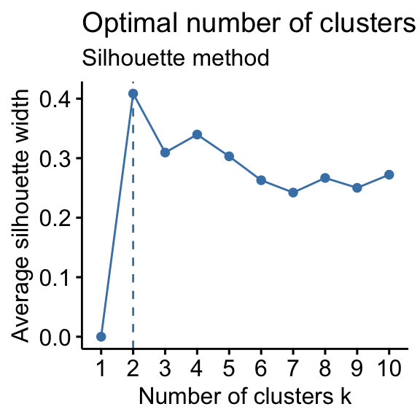
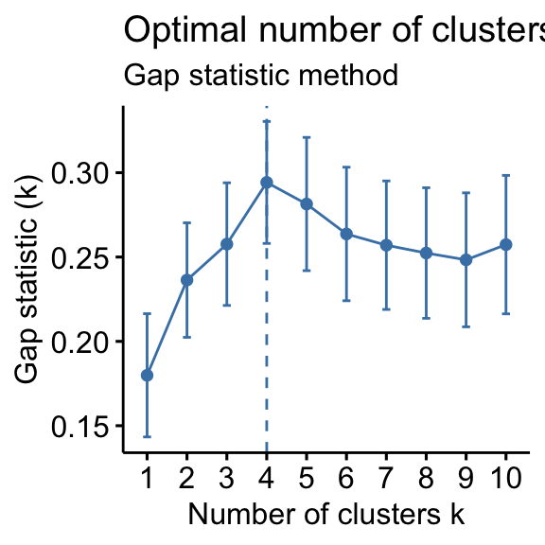
Supervised algorithms require a optimal cluster number. Silhouette approach for cluster cut-offs was the most effective cluster number selection technique
Total within-cluster sum of square (WSS)
Mean distance of point
Total within intra-cluster variation

Slide 9
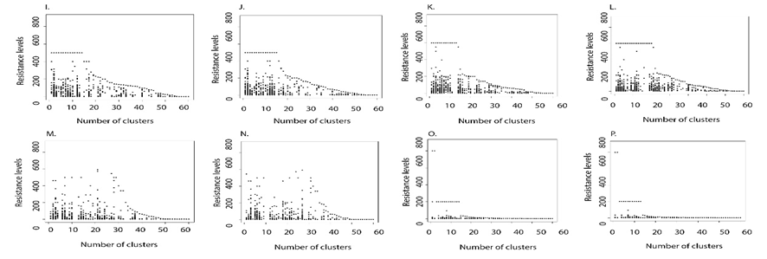
Most of the high resistance fold sequences with class 2 were clustered in first 10 clusters for most of the selected inhibitors through both hierarchical and divisive clustering delineating a clean separation between non-resistant and resistant sequences.
ATV DRV FPV IDV
LPV NFV SQV TPV
Divisive Clustering

Slide 10
Future Scope: From a pool of 100,000 only 2-35 sequences were selected common through all the 3 approaches
Category | ATV | DRV | FPV | IDV | LPV | NFV | SQV | TPV
H, D and K | 0 | 0 | 20 (66) | 0 | 35 (61) , 2 (31) | 2 (12) | 5 (58), 6 (63), 3 (73), 21 (85) | 0
Numbers in parenthesis are the cluster from which they were selected.
The resistance status of the selected sequences should be identified.
Minimum number of sequences selected for inhibitors, NFV, SQV or LPV would be some of the ideal candidates for testing in laboratory.

